Slide 1
Windows Update Internals
Why Didn’t I Get That Update?

Slide 2
Attention
MMS sessions are 60-75 minutes followed by LONG Q&A
Please hold detailed questions until that Q&A starts
Feel free to ask clarification questions
Remind the speakers to use Zoom It when you can’t see

Slide 3


Bryan Dam
Thad Martin
Patch Lover Extraordinaire, PMPC
Principal Product Manager - Microsoft
@bdam555

Slide 4
Listen Folks, We’re Gonna Get Nerdy
Like, really fricken nerdy about how this stuff all works
Notes:
Bryan: Introduce Thad My role in this session was to nerd-snipe Thad

Slide 5
Agenda
History of the first, and still best, cloud service: Windows Update
How the client orchestrates the whole process
What actually happens when a device scans?
How are update selected for a given device
Autopatch Deployment Service (maybe)
Scan Demo
Notes:
Bryan

Slide 6
The Before Times
XP and its predecessors has no meaningful patching mechanism
Windows 98: Windows Update as a web app
Critical Update Notification Utility
Windows ME/2000: Automatic Updates
Windows XP (2001): BITS, mandatory reboots
NIMDA hit in 2001 and things got real
Engineering effort from Longhorn borrowed to build "XP Springboard"
Vista (2006) introduces the Windows Update Agent
Users can postpone the restart!
GPO Configurations
Notes:
Bryan

Slide 7
Windows Update Was Cloud Before It Was Cool
Before Azure, before AWS, there was Windows Update
20+ years old
Serving nearly 2 billion devices around the world
Billions of updates
It never, ever goes down
Ok … maybe like twice
Notes:
Bryan

Slide 8
Windows Update Architecture
Microsoft Update v6 (MUv6)
Pre-Win10 1703
Microsoft Publishers
Drivers
Windows
Defender
SQL
Visual Studio
Etc.
WSUS/Catalog
updates
Win10 1703+
Delivery Catalog (DCAT)
Server/Server Sync
WSUS
Notes:
Thad

Slide 9
Why is there Windows And Microsoft Update?
Windows Update was created to secure Windows
Microsoft Update released in 2005 to secure other Microsoft products (Office, Visual Studio, SQL, etc.)
Okay, but why create a second service?
User consent is required for automatic updates
Windows: user consent is part of the EULA agreed to at install
Non-OS: user consent is obtained during software install (MU opt-in)
Opting in to MU for one product opts the machine in for all MU products.
Notes:
Bryan

Slide 10
High level workflow
Scan
Download
Install
Commit

Slide 11
High level workflow
Download
Install
Commit
Scan

Slide 12
The Client: WUA, USO, BITS, CBS, DO, UA
Let’s talk acronyms!

Slide 13
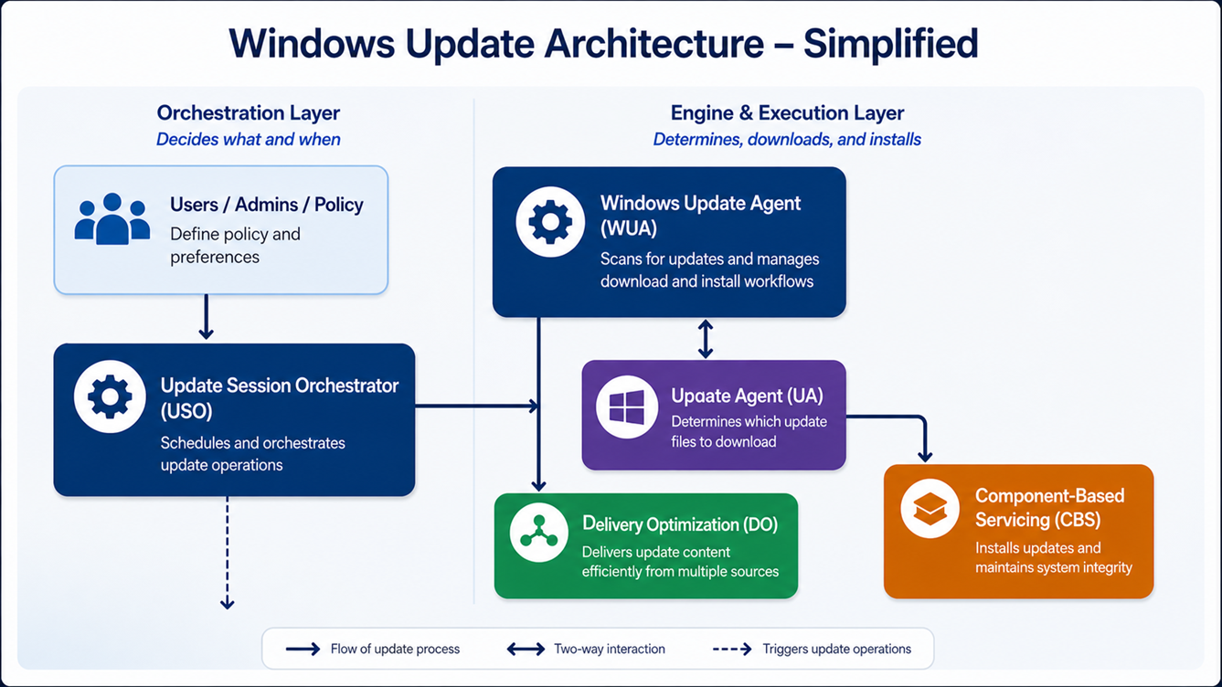
Notes:
Bryan: Flush out of tokens to fix this

Slide 14
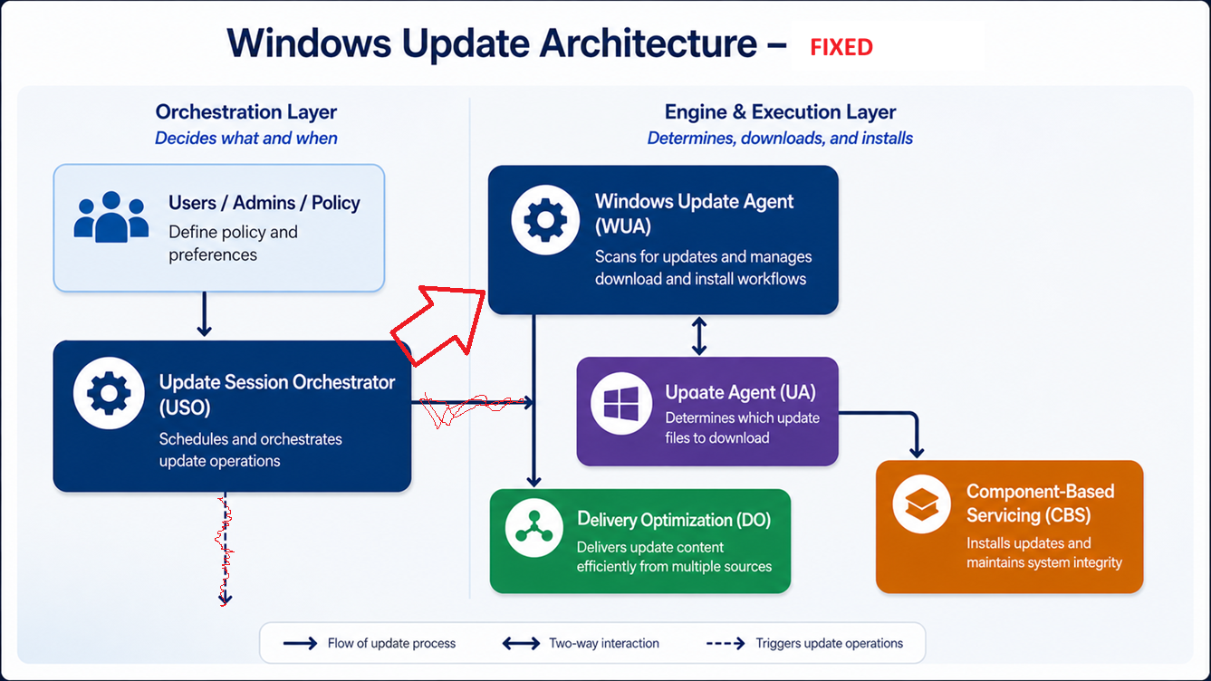
Notes:
Bryan

Slide 15
Windows Update Session Orchestrator (USO)
Introduced in Windows 10 to modernize update flow
Purpose: High-level orchestration layer over WUA
Scheduling scans/installations
Coordinating reboots and deadlines
Managing user experience and notifications
Responsibilities:
Enforce update policies (deadlines, active hours)
Coordinate maintenance windows
Resume interrupted updates
Handle automatic retries and resiliency
Used By:
Windows Update for Business / Autopatch
Microsoft Intune
Notes:
Bryan

Slide 16
WUA: Windows Update Agent
Core component since early Windows Update era (XP)
API enabling programmatic control of updates
Responsibilities:
Scan for applicable updates
Evaluate applicability rules (supersedence, prerequisites)
Download updates (via DO)
Install updates (via CBS)
Used by:
USO
Configuration Manager
Custom scripts/tools (PowerShell, VBScript, C++)
Notes:
Bryan

Slide 17
Background Intelligent Transfer Service (BITS)
Introduced in Windows XP to protect networks
Purpose: enable efficient, non-disruptive downloads
Key capabilities:
Throttled bandwidth usage (respects idle network capacity)
Automatic pause/resume (network drops, reboots)
Checkpointing (resumes partial downloads)
Queue-based job (download/upload)
Supports BranchCache
Used by:
WUA to download update content
Other MS services
Legacy: Replaced by ...
Notes:
Bryan

Slide 18
DO - Comprehensive solutions to minimize Internet bandwidth
Delivery Optimization Client
Distributed
Your own devices contribute to reduce the overall Internet bandwidth
Download reliably from multiple http and peer sources in parallel
Cloud managed peer discovery to find the best local sources
Flexible download throttling controls
Microsoft Connected Cache
Dedicated
Transparently and dynamically cache content delivered through Delivery Optimization, consumed by devices on your network​
Better bandwidth reductions in sites with limited access
Supporting networks where peer-to-peer cannot be used (ex: all VPN Wi-Fi network)
Notes:
Thad – or Andy?

Slide 19
Unified Update Platform (UUP)
Designed to unify all Windows servicing workflows (flighting/retail, phone/desktop, upgrade/update)
Feature Updates switched to UUP in Win10 1703, Quality Updates switched in Win10 1709
Benefits:
Smaller, smarter downloads on each endpoint
Get current in one step with cumulative Quality Updates
Feature Updates land on the latest Quality Update and preserve installed languages and features (FODs)
Notes:
Thad

Slide 20
UUP: Update Agent
UUP updates contain bootstrap files that are downloaded first:
Metadata files describing the contents of the update
Update Agent, a .dll that determines which update files to download
Update Agent parses the metadata files and compares them to what is installed
Once files are downloaded, Update Agent hands them to CBS for install
Notes:
Thad

Slide 21
UUP client workflow
WUA
Update
1
Update agent
1
WUA downloads bootstrap files
2
Metadata file
2
WUA launches Update Agent (UA) which reads the metadata file
File1
3
UA downloads only needed files
File2
3
4
UA triggers install/reboot/commit
…
4
FileN
*
UA interacts w/ WUA to provide progress,
download files, report status, etc.
Notes:
Thad
COM interface between WUA and UpdateAgent

Slide 22
Component-Based Servicing (CBS)
Introduced in Windows Vista, replacing legacy update mechanisms
Purpose: Windows servicing and installation engine
Handles installation of updates, features, and system components
Transaction-based model ensures safe install/uninstall
Responsibilities:
Package installation (.msu, .cab)
Dependency resolution and applicability
Component versioning and side-by-side (WinSxS) management
Rollback on failure
Used by:
Windows Update Agent
DISM (optional features, language packs)
Notes:
Bryan

Slide 23
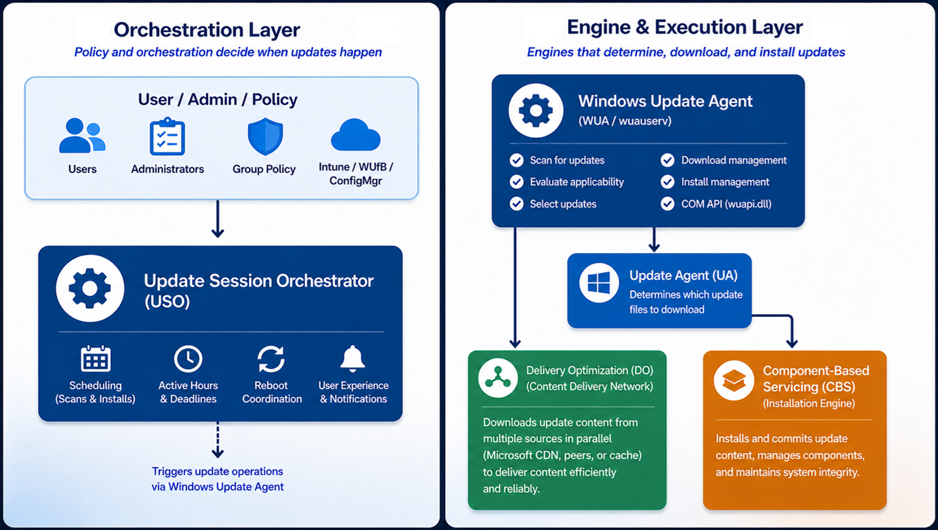

Slide 24
Widows Update Service: MUv6 vs DCAT
Enough acronyms, give us the cloud!

Slide 25
High level workflow
Scan
Download
Install
Commit

Slide 26
High level workflow
Scan
Download
Install
Commit

Slide 27
How Does It Work: MUv6 Scan
Client evaluates applicability locally (rules engine)
MUv6 pruning model
Product Category scoping limits initial graph roots
Detectoids prune the branches
Server returns only reachable + changed nodes (revision-cookie delta)
Supersedence collapses graph paths (older nodes become unreachable)
Client evaluates applicability over reduced working set
WSUS uses this same protocol
Notes:
Thad

Slide 28
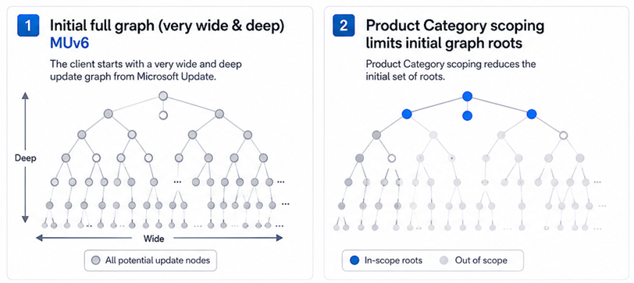
Notes:
Bryan

Slide 29
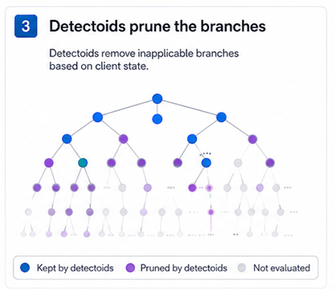
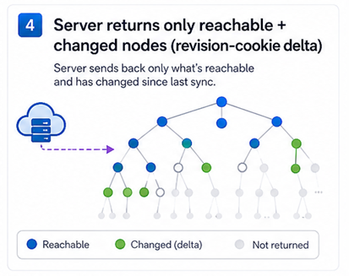
Notes:
Bryan

Slide 30
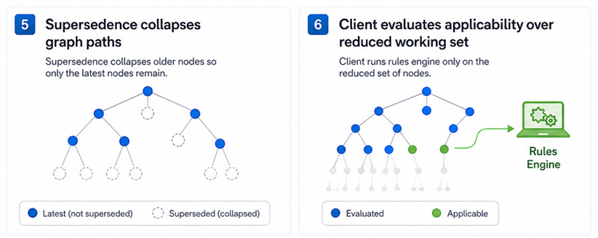
Notes:
Bryan

Slide 31
MUv6 challenges
Client performance + scale issues
Inefficient, chatty protocol
It’s a choose your own adventure game
Too much logic in the client (limits agility)
Notes:
Thad
Client performance + scale issues The MUv6/WSUS model causes large local datastore growth and expensive scans—especially the first scan, which requires downloading and reasoning over a lot of metadata.
Inefficient, chatty protocol The pruning model requires multiple round trips between client and service to converge on applicable updates, which drives unnecessary bandwidth and latency.
Too much logic in the client (limits agility) Applicability evaluation lives heavily in the client, so any change requires updating clients broadly—making it slow to evolve compared to a service-driven model like DCAT.

Slide 32
A note on WSUS deprecation
WSUS remains a supported role in Windows Server 2025
Server 2025 is in support until 2035
Paid extended support likely for some period beyond 2035
WSUS in Server 2025 continues to support patching of all supported versions of Windows client and Windows Server
This provides at least a 10-year runway for another solution
We know a solution for airgap is needed
Notes:
Thad

Slide 33
How Does it Work: DCAT Scan
Client sends products and attribute info to DCAT:
Installed products (e.g., Windows, Defender, etc.) & versions
Device attributes (arch, OS version, policy values, etc.)
DCAT identifies the latest applicable version for each product
Drivers and Quality Updates have targeting logic based on device attributes (i.e., expressions)
Some updates (e.g., Feature Updates, WIP) use “list-based” targeting, and can target on authenticated identities (MSA, Entra) or device IDs.
DCAT offers the latest applicable version if higher than the installed version.
Notes:
Thad

Slide 34
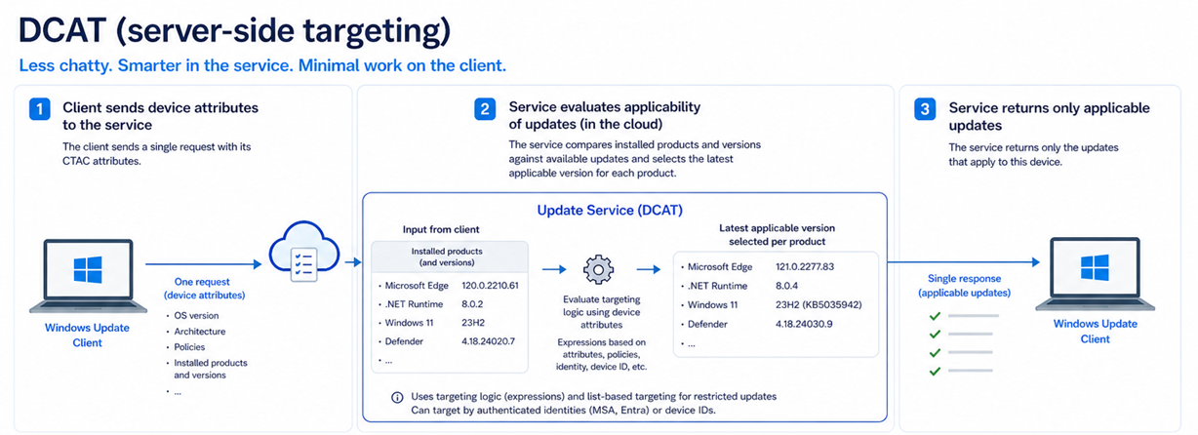

Slide 35
DCAT: Device Attributes
Common Targeting Attribute Client (CTAC)
New CTAC attributes are defined in the cloud, then pushed to devices via a configuration service
Typically set by the system or registry keys
The WU Client includes CTAC attributes in its scan
OS version, architecture, policies, etc.
You can see the list of CTAC attributes in a Windows Update log
Notes:
Thad

Slide 36
Demo: Where’s my update?
Toaster device with HWID: DSSTest3HWID1
Initial version: 1.0.0.0
Two versions on WU:
1.0.0.1 (UpdateId: EC2B044A-A8B4-4BC2-AA27-197560963941)
1.0.0.2 (UpdateId: D4FA4026-D81B-4FA4-847A-812E8689DF97)
Why isn’t 1.0.0.2 offered?
Notes:
Thad
Demo steps:
Add test device, pull up driver version in Device Manager (1.0.0.0)
Scan WU, note the time, see new driver version 1.0.0.1 install
Set partner test reg key
Scan WU, note the time, see new driver version 1.0.0.2 install
Copy relevant .etl files from %windir%\Logs\WindowsUpdate to a different folder
Decode .etl files (Get-WindowsUpdateLog), open folder in VS Code
Open WindowsUpdate.log, search for DeviceAttributes (CTAC) with the timestamp of the first scan
Select the relevant text and ask GitHub Copilot to generate a JSON file of the attributes
Search for DeviceAttributes (CTAC) with the timestamp of the second scan
Create another JSON
Ask Copilot to compare, or visually compare

Slide 37
How to investigate missing updates
Collect WU log .ETL files (%windir%\Logs\WindowsUpdate)
Decode the .ETL files in PS using Get-WindowsUpdateLog
Search for “DeviceAttributes (CTAC)”
Compare with a different machine getting the update
Notes:
Thad

Slide 38
Scan Source
What is this madness?

Slide 39
Scan Source
Evolution of Dual Scan, introduced surreptitiously in Windows 10
Allows administrators to select the source of updates by type
Feature Update, Quality Updates, Driver Update, Other (MS) Updates
If enabled: third-party updates always come from WSUS, if specified
Ex: Drivers from WU/MU but FUs from WSUS/ConfigMgr
Scans both WU/MU and WSUS and filters the results
Blog: SCCM Co-management – Dual Scan and Scan Source Demystified

Slide 40
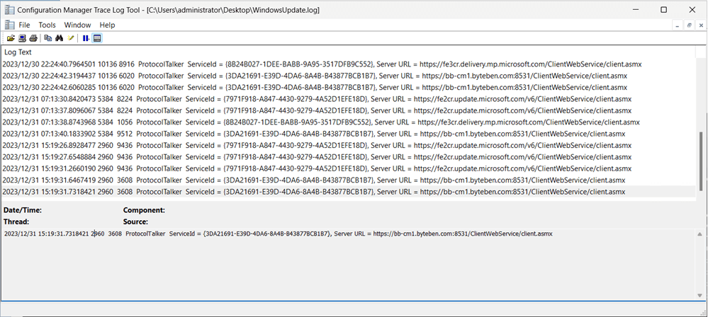
Scan Source: Know They Sources
Filter the log for “ProtocolTalker ServiceId =‘
Notes:
Bryan

Slide 41
Scan Source: Know They Sources
Unspecified / Default | Windows Update, Microsoft Update, or WSUS 00000000-0000-0000-0000-000000000000
Windows Update | 9482F4B4-E343-43B6-B170-9A65BC822C77
Microsoft Update | 7971f918-a847-4430-9279-4a52d1efe18d
Store | 855E8A7C-ECB4-4CA3-B045-1DFA50104289
OS Flighting | 8B24B027-1DEE-BABB-9A95-3517DFB9C552
WSUS Configuration Manager | 3DA21691-E39D-4da6-8A4B-B43877BCB1B7
Notes:
Bryan

Slide 42
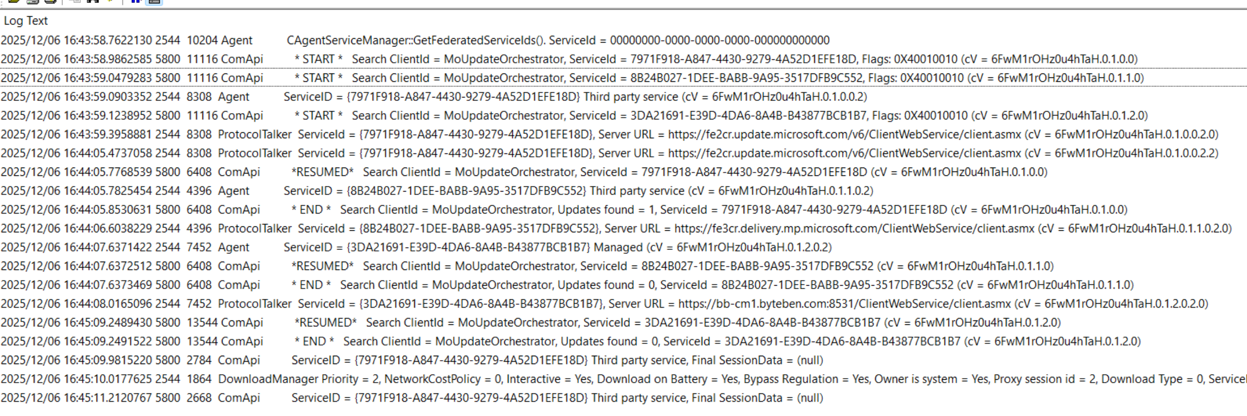
Scan Source: The Logs
Notes:
Bryan

Slide 43
What If The Cloud Service Had An API?
Oh the fun we could have
Notes:
Bryan

Slide 44
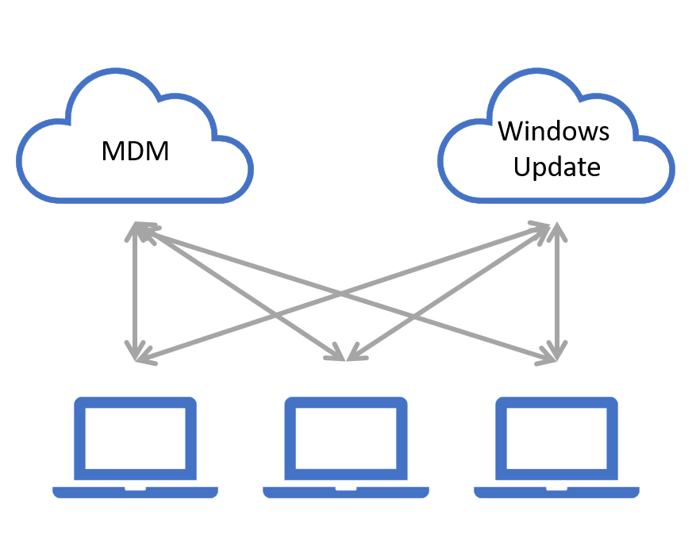
The Problem
Notes:
Bryan

Slide 45
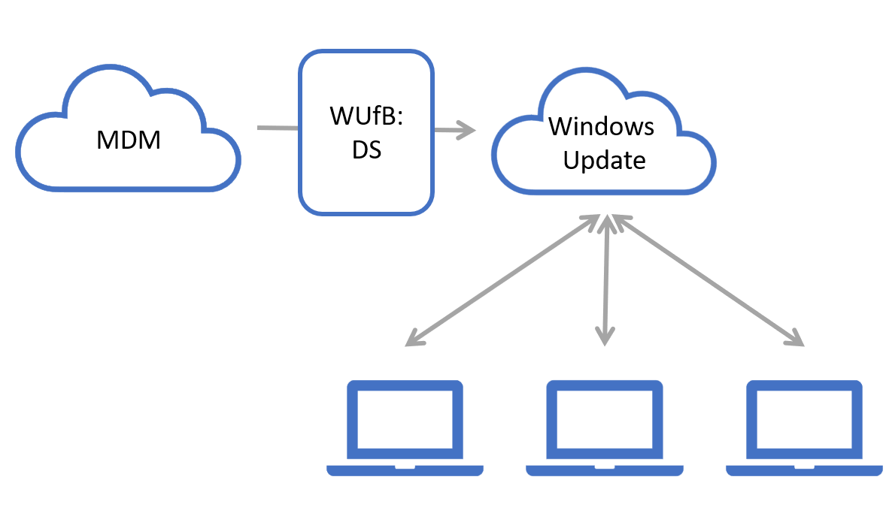
The Solution
Notes:
Bryan

Slide 46
The Autopatch Deployment Service
An API around the Windows Update cloud service
Fully programmable via the Graph API
Intune is a premier consumer but open to all
Key Features
Feature Update Policies
Quality Update Policies (Expedite)
Driver Management

Slide 47

Mid-altitude
Client Device: Native WU
IT Management
AAD domain-joined device scans WU
WU consults
Deployment Service
Browse applicable content
IT admin approval, scheduling
& monitoring
MS Graph calling applications, like Intune
Only IT approved content offered
Deployment Service sends approvals to WU
Approve content
https://graph.microsoft.com/beta/admin/windows/updates/*

Slide 48
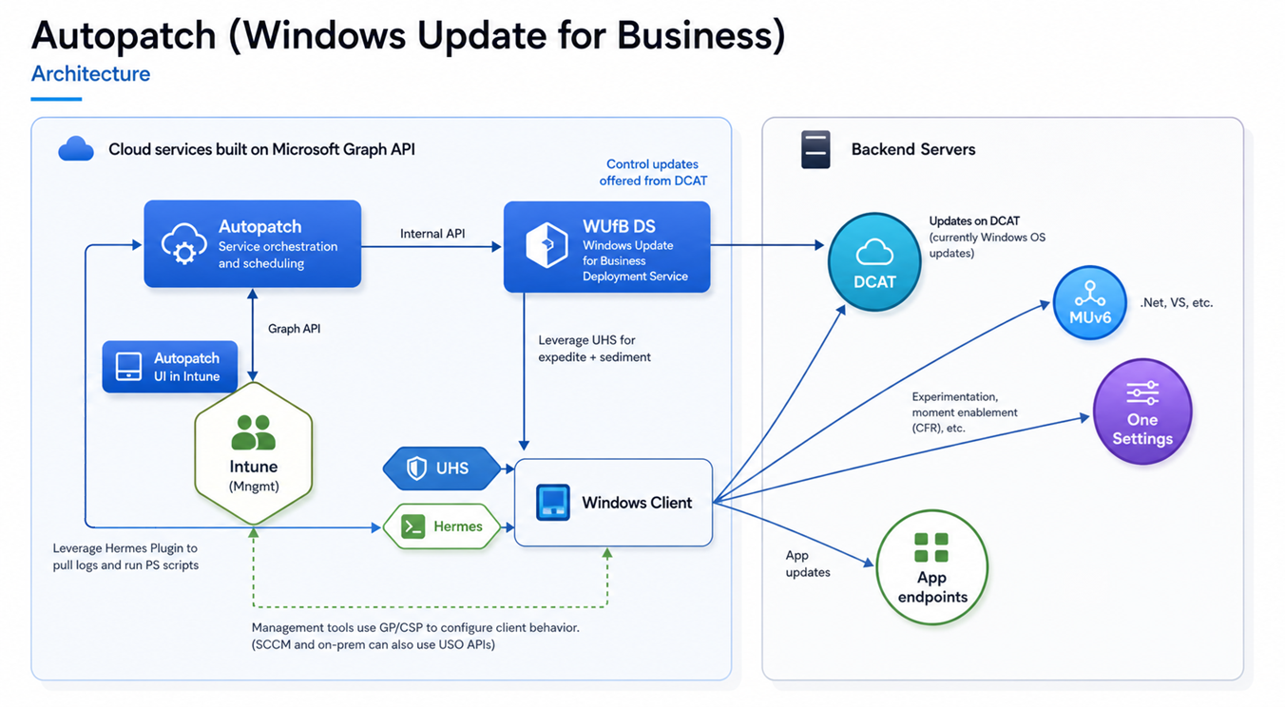

Slide 49
Wednesday 8-10 AM

